Slide 1
DataVIZ-UI
Project Structure

Slide 2
Introduction
component-based project architecture
Project folder structure creation based on features
Every feature folder have
components folder
Index .ts
Index.ts file define the Sub Module.
Every components folder have sub feature folders.
Every sub features folder have 2 files
component definition file(SubFeatureName.component.ts)
template file(SubFeatureName.html)
Charts & Girds used to data visualization for Equipment details .
Maps shows last reported Equipment location.

Slide 3
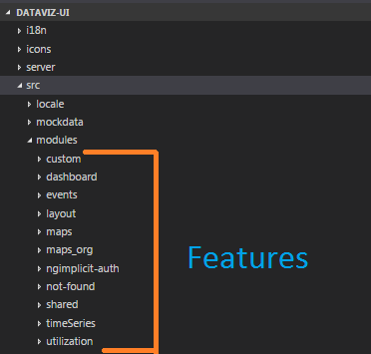
Project Folder structure creation based by features

Slide 4
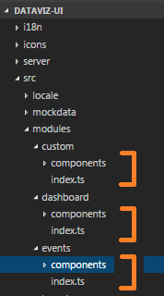
Every feature folder have components folder and index.ts

Slide 5
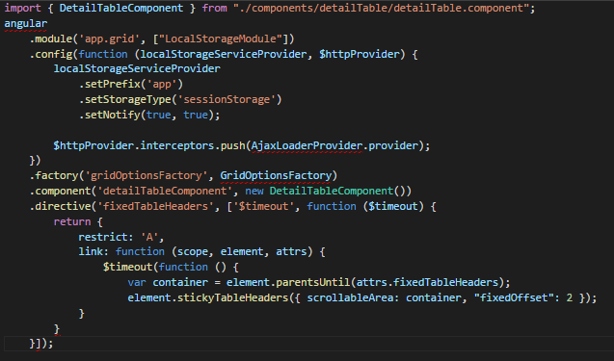
Index.ts file define the Sub Module.

Slide 6
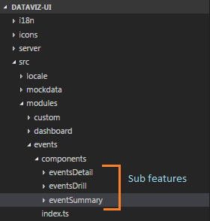
Every components folder have sub feature folder.

Slide 7
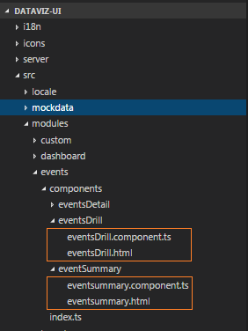
Every sub features folder have 2 files i) component definition file(subfeature_name.component.ts) ii) template file(subfeature_name.html)

Slide 8
gulpfile.js - task Manager
We can write any task script. For example
Build
Type script to Javascript
Scss to Css

Slide 9
Package.json - Pack the dependencies Java script files
It serves as documentation for what packages your project depends on.
It allows you to specify the versions of a package that your project can use using semantic versioning rules.
Makes your build reproducable which means that its way easier to share with other developers.
To add an entry to your package.json's dependencies:
npm install <package_name> --save
To add an entry to your package.json's devDependencies:
npm install <package_name> --save-dev

Slide 10
Package.json - Version number Explanation
Version Number | Explanation
latest | Takes the latest version possible. Not the safest thing to use.
*, x | Wildcards. Can be any version at all. Crazy stuff.
4, 4.*, 4.x, ~4, ^4 | Any version that starts with 4. Takes the latest.
>4.8.5 | Choose any version greater than a specific version. Could break your application.
<4.8.5 | Choose any version lower than a specific version.
>=4.8.5 | Anything greater than or equal to a specific version.
<=4.8.5 | Anything less than or equal to.
4.8.3 - 4.8.5 | Anything within a range of versions. The equivalent of >=4.8.3 and <=4.8.5
~4.8.5 | Any version “reasonably close to 4.8.5”. This will call use all versions up to, but less than 4.9.0
~4.8 | Any version that starts with 4.8
^4.8.5 | Any version “compatible with 4.8.5”. This will call versions up to the next major version like 5.0.0. Could break your application if there are major differences in the next major version.
^1.2 | Any version compatible with 1.2

Slide 11
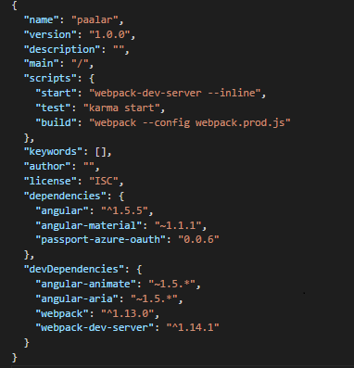
Package.json - Pack the dependencies Java script files

Slide 12
Server.js
Initiate port no and start server
Route Configuration for web service
Configure Authenticate verification

Slide 13
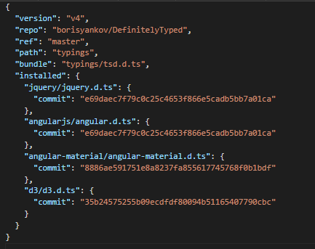
Tsd.json - TypeScript Definition manager for DefinitelyTyped

Slide 14
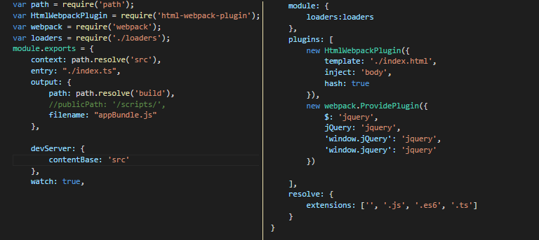
Webpack.config.js - Package Manager

Slide 15
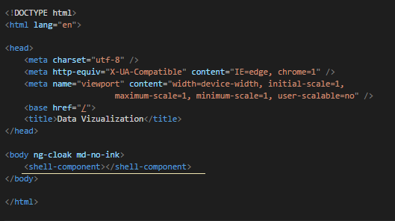
Index.html - Entry Page

Slide 16
Index.ts - Main module
Main app module set here.
And main module extents support modules and all sub modules
config the headers values and disable the warnings
bootstrap the app module

Slide 17
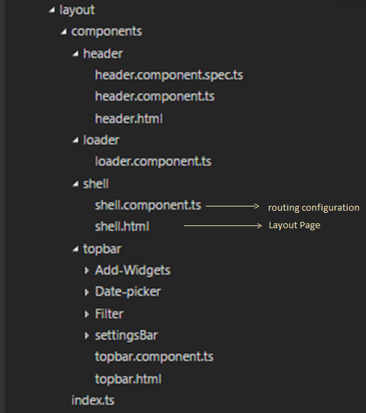
Layout

Slide 18
Workspace setup
node-v6.9.5-x64
DataViz-UI>tsd install
DataViz-UI>npm install
DataViz-UI>npm install angularjs@1.5.8
DataViz-UI>npm install gulp --save
DataViz-UI>npm install api-rest-client
DataViz-UI>gulp build
DataViz-UI>gulp npmstart

